Slide 1


History of Military Aviation Fuels
Tim Edwards
Fuels Branch
Aerospace Systems Directorate
Air Force Research Laboratory

Slide 2
Background
Transportation fuels and power generation are the big players in the U.S. energy (and CO₂) picture
Petroleum is predominantly used to make transportation fuels currently
Sustainable (non-fossil) aviation fuels are becoming available slowly
The history of (military) aviation fuel development may offer some guidance about accelerating this transition

Slide 3
Energy Consumption

Slide 4
CO₂ Emissions

Slide 5
References
Martel, C. R., “Military Jet Fuels, 1944-1987,” Air Force Wright Aeronautical Lab., Rept. AFWAL-TR-87-2062, Nov. 1987 (DTIC ADA186752).
Dukek, W. G., et al., “Milestones in Aviation Fuels,” AIAA 69-779, 1969.
Ogston, A., “A Short History of Aviation Gasoline Development, 1903-1980,” Trends in Aviation Fuels and Lubricants, SP-492, Society of Automotive Engineers, Warrendale, PA, 1981, pp. 1–14.
Heron, S. D., “Development of Aircraft Engines and Fuels,” edited by R. Schlaifer and S. D. Heron, Harvard Univ., Boston, 1950, pp. 545–662.
Edwards, T., "Advancements in Gas Turbine Fuels From 1943 to 2005," Journal of Engineering for Gas Turbines and Power, Vol. 129, pp. 13-290, 2007.
Edwards, T., “Liquid Fuels and Propellants for Aerospace Propulsion: 1903–2003,” Journal of Propulsion and Power, Vol. 19, No. 6, November–December 2003.
Chevron Aviation Fuel Handbook online

Slide 6

Energy Density Critical
1.2
18,600 BTU/lb
diesel
Liquid
Hydrocarbons
jet fuel
FT jet
1
gasoline
avgas
114,200 BTU/gal
0.8
Alcohols
ethanol
0.6
Energy Density per unit Volume
Increasing range
(relative to gasoline)
methanol
Hydrogen
0.4
metal hydride
liquid
containment
0.2
10,000 psi gas
0
lithium ion battery
0
1
2
3
Energy Density per Unit Mass
(relative to gasoline)
Decreasing specific fuel consumption
Navy

Slide 7
In The Beginning…
Wright Brothers flew on “several cans of Standard Oil motor gasoline from a nearby boatyard” [Crouch]
Current world consumption of jet fuel is over 100 B gallons per year. Not obtained from nearby boatyards!
How did we get from 1903 fuels to 2021 fuels? And where are we going?

Slide 8
Evolution of Avgas
Petroleum distillates like aviation gasoline (“avgas”) are complex mixtures of thousands of hydrocarbon molecules
Mixture composition varies with crude source
Engine power limited by “knock” (premature detonation)
Key steps to understanding and improving avgas properties include (1910-early 20s):
  Development of octane rating scale (Edgar)
    1903 fuel estimated to be 38-50 octane
  Standardized knock rating method/engine (Horning)
  Discovery of tetraethyl lead (TEL) (Midgley and Boyd)
Notes:
Avgas
Wrights used mogas
Gasoline definition/boiling range
a/c drove understanding of octane number - knock
Piston engine description – supercharge/turbocharge
Ricardo/knock chemistry/”fighting grade” benzol
Kettering/Midgeley/Boyd TEL – data for effect
McCook field – a/c effect of octane
100 octane – Heron et al – dyes/grades
High octane base stock – alkylation – data for refining volume increase -
AF Museum pix

Slide 9
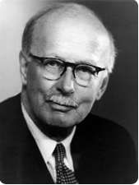
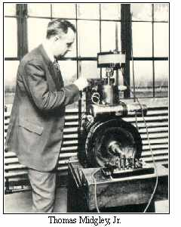
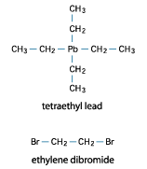
The Problem of Knock
“Knock” was the major limiter to increases in aircraft engine performance
Tetraethyl lead was a key enabler of higher performance engines
Of course, lead is pretty nasty stuff……..
Sir Harry Ricardo
Thomas A. Midgley and T.A. Boyd, "Detonation Characteristics of Some Blended Motor Fuels," SAE Journal, June 1922, page 451.

Slide 10
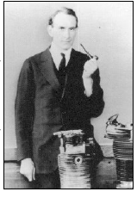
Higher Octane Avgas
Army Air Corps at McCook/Wright Fields (Dayton) pushed engine benefits of higher octane fuels with TEL
First specification for 100 octane in 1934
High octane fuels credited with key role in winning Battle of Britain
  RR Merlin engine produced >5X more horsepower than WWI engine of same displacement
Avgas production increased from 54 million gallons/yr in 1932 to 25 million gallons/DAY at end of WWII
Culmination of avgas development was specification for 115/145 octane fuel (lean/rich)
Samuel Heron
F. D. Klein, “Aircraft Engine Performance with 100 Octane Fuel,” Journal of Aeronautical Sciences 2, March 1935, pp. 43-47.

Slide 11
Evolution of Engine Performance
Figure 12.3 Engine Data Representative of the Development of Aircraft Piston Engines
Engine | Year | Design | Coolant | Number of Cylinders | Displacement, cubic inches | Horsepower (hp) | Weight, lbs | lb/hp
Wright | 1903 | In-line | Liquid | 4 | 200 | 12 | 179* | 14.9
Anzani | 1910 | Radial | Air | 3 | 190 | 30 | 121 | 4.0
Gnome | 1908 | Rotary | Air | 7 | 488 | 50 | 165 | 3.3
Bentley BR2 | 1918 | Rotary | Air | 9 | 1522 | 230 | 500 | 2.2
Rolls-Royce Condor | 1918 | "V" | Liquid | 12 | 2138 | 650 | 1300* | 2.0
Wright J-5 Whirlwind** | 1925 | Radial | Air | 9 | 788 | 220 | 510* | 2.3
Rolls-Royce Merlin | 1936 | "V" | Liquid | 12 | 1650 | 1030 | 1320* | 1.3
Mercedes-Benz D-B 601 | 1938 | "V" | Liquid | 12 | 2069 | 1360 | 1540* | 1.1
Napier Sabre | 1940 | "V" | Liquid | 12 | 2240 | 2200 | 2500* | 1.1
Allison V-1710 | 1941 | "V" | Liquid | 12 | 1710 | 1250 | 1595* | 1.3
Pratt & Whitney R-4360 | 1945 | Radial | Air | 28 | 4360 | 3000 | 3600 | 1.2
Continental O-200 | 1959 | Opposed | Air | 4 | 201 | 100 | 188 | 1.9
Lycoming O-540 | 1959 | Opposed | Air | 6 | 542 | 250 | 396 | 1.6
Lycoming XR-7755 | mid 1940s | Radial | Liquid | 36 | 7755 | 4000 | 6050* | 1.5
Lycoming IO-540-K | 1960s | Opposed | Air | 6 | 542 | 300 | 443 | 1.5
Lycoming TIO-540-J | 1960s | Opposed | Air | 6 | 542 | 350 | 518 | 1.5
* These weights do not include the weight of liquid coolant, heat exchangers, and/or other accessories.
** This engine powered the Spirit of Saint Louis in Charles Lindbergh's historic flight from New York to Paris in 1927.
Sources: A History of Aircraft Piston Engines, Herschel Smith and Jane's All the World's Aircraft.
Chevron

Slide 12
Hydrocarbon Types in Fuels
OCTANE NUMBERS
0
98
100
71
77

Slide 13

Hydrocarbon Types in Fuels
Figure 10.2 Potential Contribution* of Each Hydrocarbon Class to Selected Avgas Properties (For hydrocarbons in the avgas carbon number range)
 | Hydrocarbon Class
Avgas Property | n-Paraffin | Isoparaffin | Naphthene | Aromatic
Lean-mixture antiknock | – – | +/++ | 0/– | +/++
Rich-mixture antiknock | – – | + | 0/– | ++
Low-temperature fluidity | – | +/++ | 0/+ | –
* "+" indicated a beneficial effect, "0" a neutral or minor effect, and "–" a detrimental effect.
Refinery process for high octane base stock
Chevron

Slide 14
Aviation Gasoline Today
Tiny fraction of aviation fuel market in the U.S.
Figure 7.1 Grades of Aviation Gasoline in the United States
1950s | Today*
73 | –
80/87 | 80
91/98 | –
100/130 | 100, 100LL**
108/135 | –
115/145 | –
* ASTM D 910 ** LL = Low Lead. Grade 100LL contains less tetraethyl lead antiknock additive than Grade 100.
Chevron

Slide 15
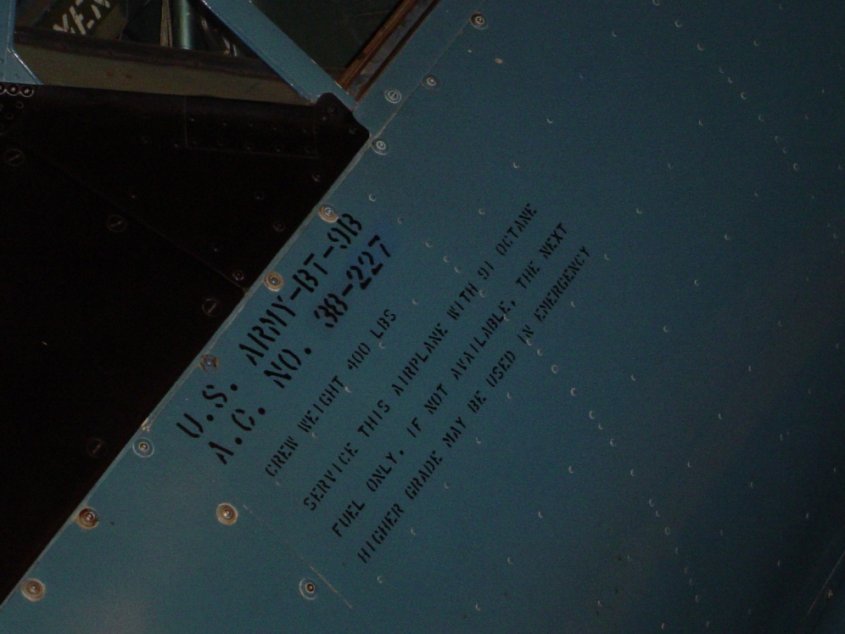
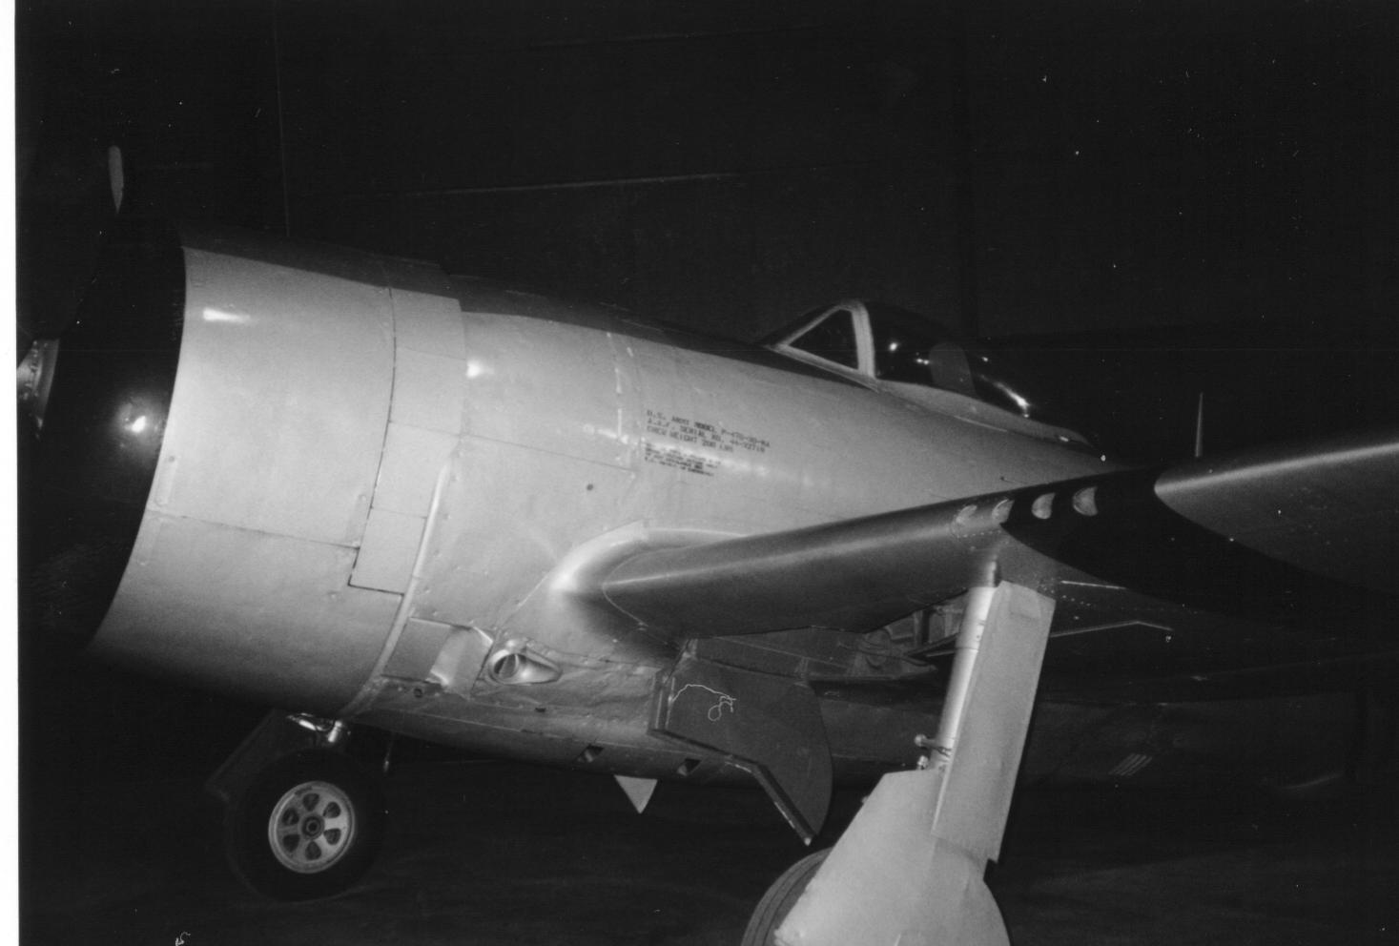
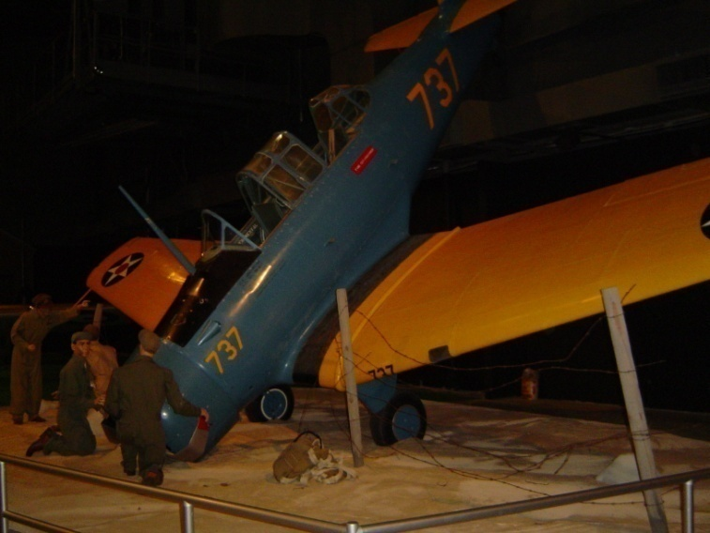
Fuels and the Air Force Museum
Read the “fine print”!
Octane number req’ts range from 91 (BT-9) to 100 to 115/145 (many aircraft)
Several aircraft labeled “suitable for aromatics” (high octane)
The “fine print”

Slide 16
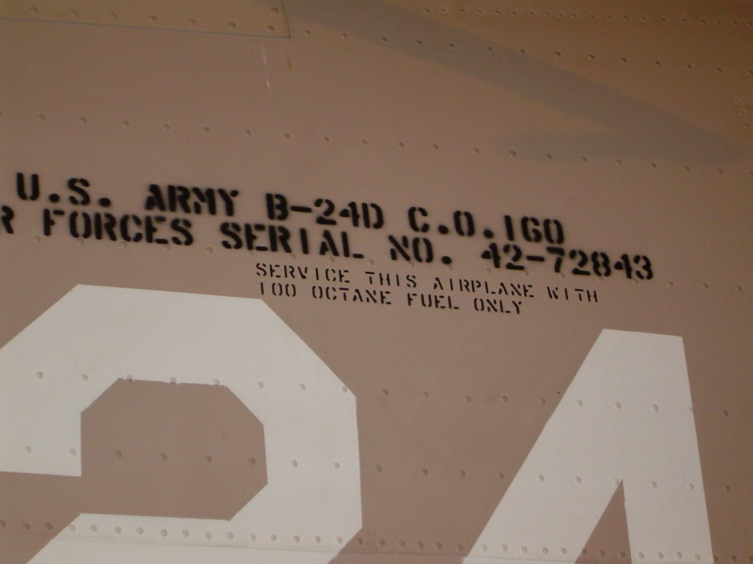
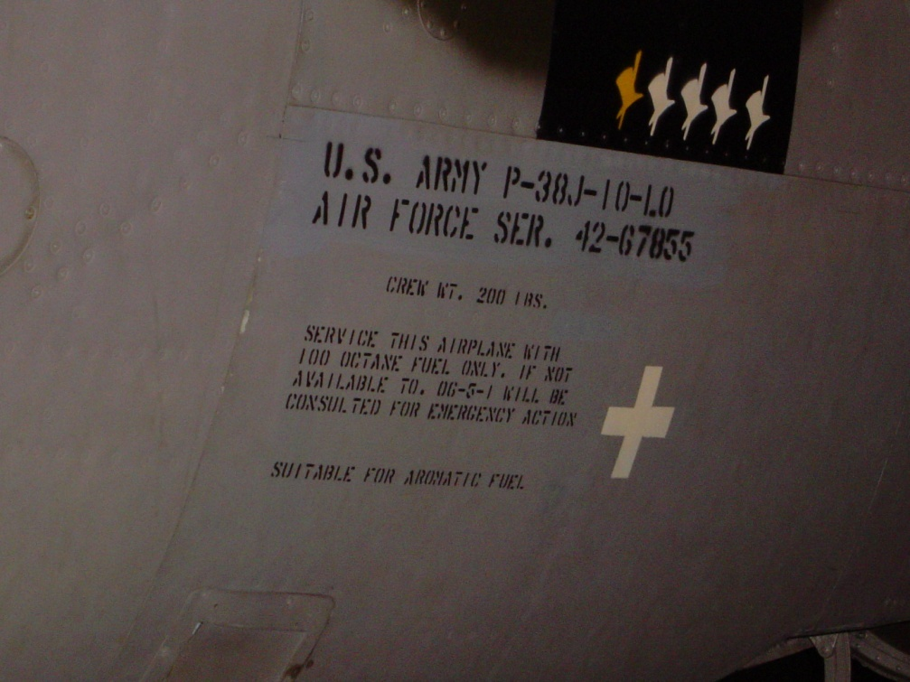
More Fine Print
100 octane fuel first common marking

Slide 17
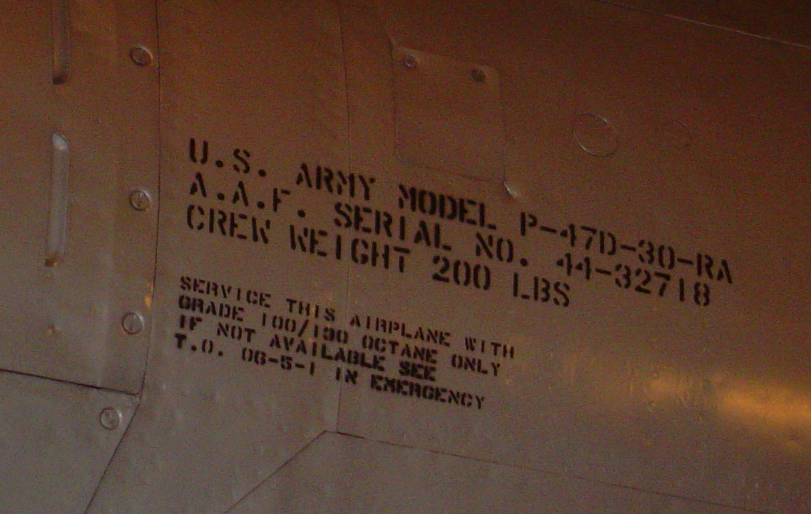
Fine Print (cont.)
Specification evolved to include lean (cruise) and rich (take-off) octane requirements

Slide 18
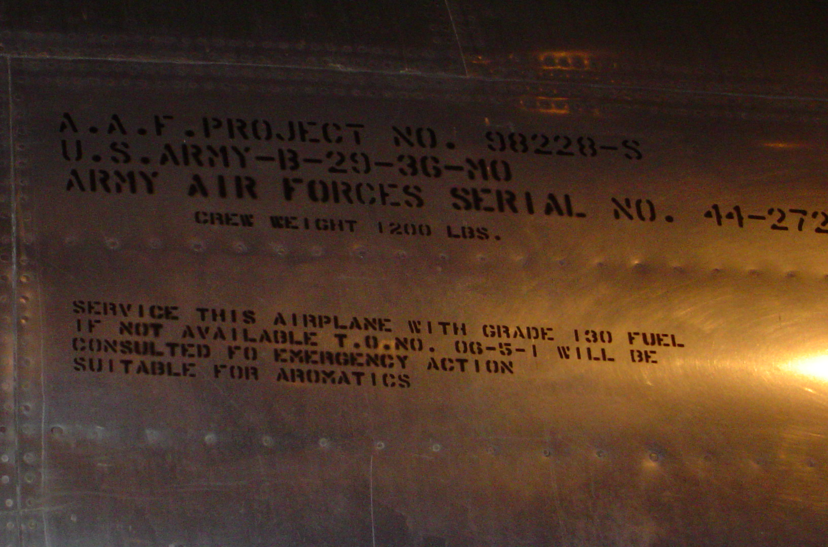
Fine Print (cont.)
Addition of aromatics to increase octane allowed

Slide 19
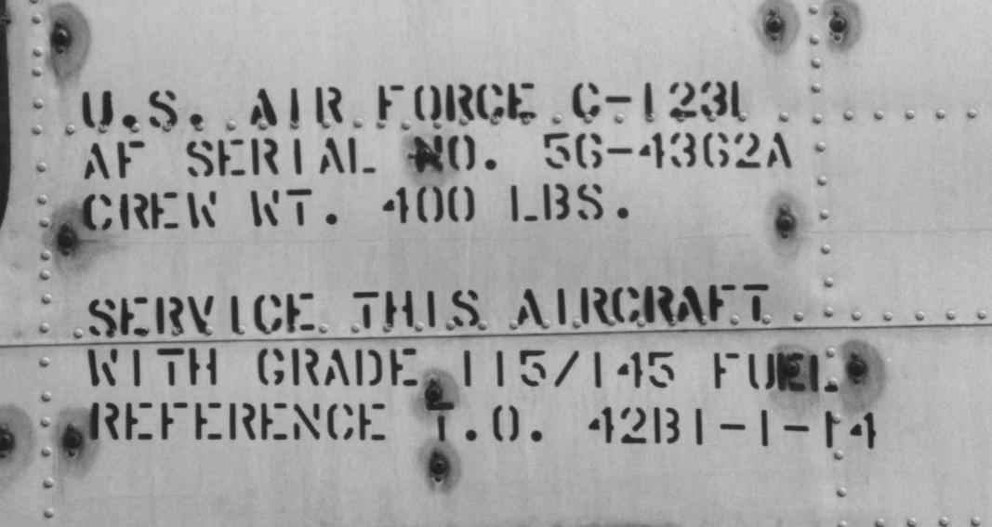
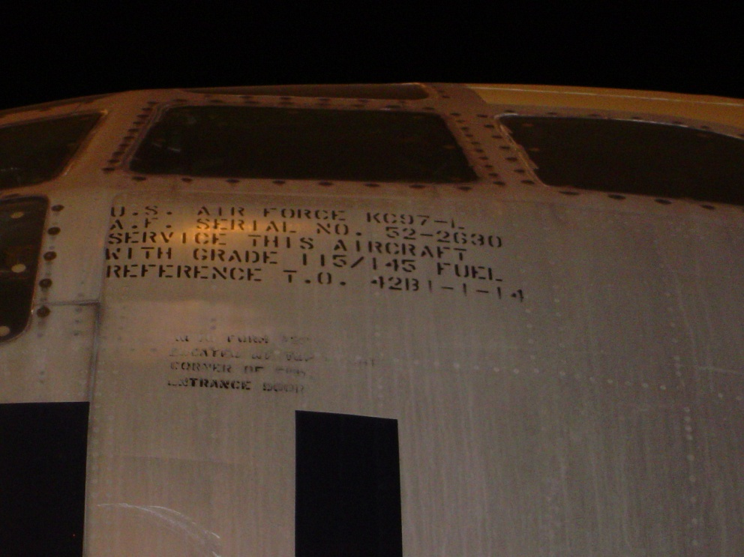
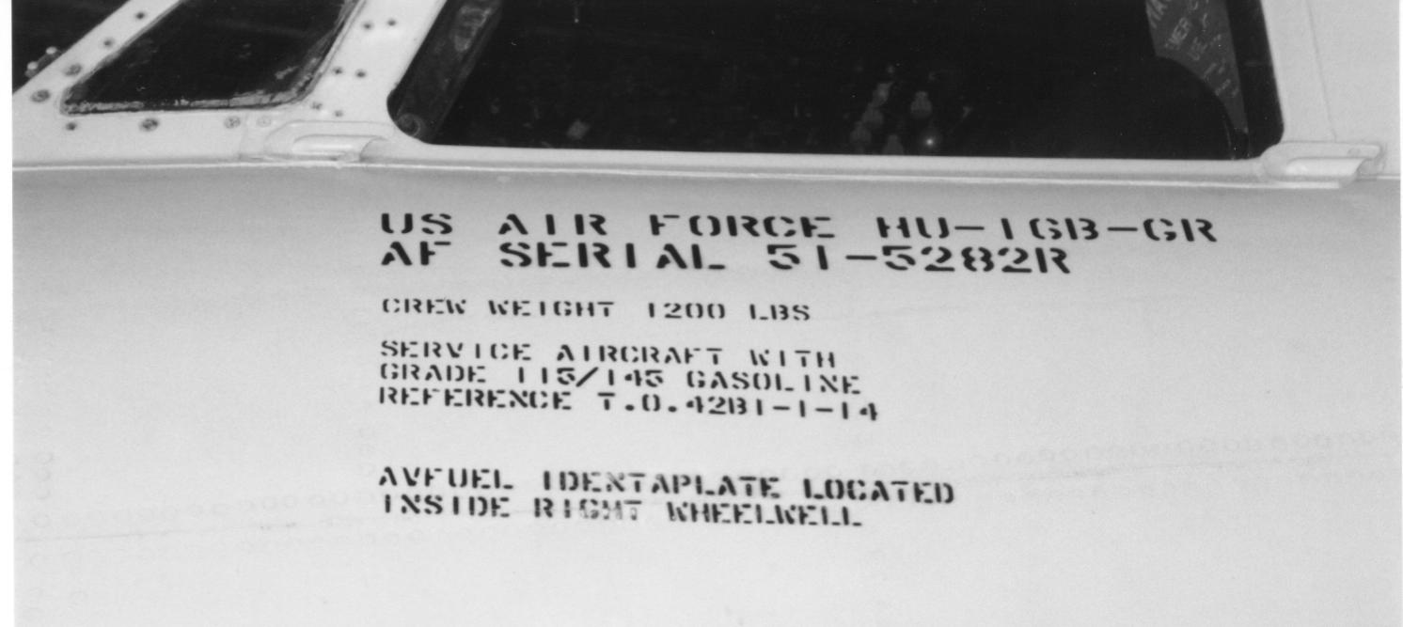
Fine Print (cont.)
115/145 octane was the highest performance specification
Various dyes used to distinguish grades of fuel

Slide 20
The Advent of the Gas Turbine
Gas turbines can operate with a wide variety of fuels
In late 40s/early 50s, specifications for “jet propellant” traded off availability (cost), freeze point, and volatility: JP-1, JP-2, JP-3 not satisfactory
JP-4 was a mix of gasoline-range and kerosene – became primary military fuel from mid 1950s to 1980s
Commercial and Navy jet fuels were kerosenes for fire safety reasons (Jet A/Jet A-1/JP-5)
USAF switched to kerosene jet fuel in 1980s (JP-8)
USAF switched to commercial jet fuel in 2014 (Jet A + additives = “F-24”)
Notes:
Jet Fuel
Gas turbine – Whittle/Von Ohain (gas turbine = speed)
Fuel – early work to work out trade between volatility/freeze point/cost
Final – JP-4/Jet A-1 (Museum pix)
Civil jet service mid 50s – problems – but show changes beginning in 60
High bypass -> lower SFC turbojet vs turbofan
JP-4 changes to JP-8
World wide spec/joint check list
Spec
Spec tests/why?
Combustion – aromatics vs liner life, etc.
Freeze pt vs volatility/flash
Stability/contaminants/sulfur (nozzle life vs breakpoint)
Additives
Missile fuels/specialty fuels – esp JP-7, JP-TS, JP-10, slurries

Slide 21
Aviation Fuel Changes
First commercial jet airliner in 1959
Current usage is roughly 10% military, 90% commercial in U.S.

Slide 22
Military Gas Turbine Fuels
Figure 3.1 U.S. Military Jet Fuels
Fuel | Year Introduced | Type | RVP, psi | Freeze Point ºC max | Flash Point ºC min | Comments
JP-1 | 1944 | kerosene |  | – 60 | 43 | obsolete
JP-2 | 1945 | wide-cut | = 2 | – 60 |  | obsolete
JP-3 | 1947 | wide-cut | 5 - 7 | – 60 |  | obsolete
JP-4 | 1951 | wide-cut | 2 - 3 | – 72 |  | U.S. Air Force fuel
JP-5 | 1952 | kerosene |  | – 46 | 60 | U.S. Navy fuel
JP-6 | 1956 | kerosene |  | – 54 |  | XB-70 program, obsolete
JPTS | 1956 | kerosene |  | – 53 | 43 | Higher thermal stability
JP-7 | 1960 | kerosene |  | – 43 | 60 | Lower volatility, higher thermal stability
JP-8 | 1979 | kerosene |  | – 47 | 38 | U.S. Air Force fuel
JP-8+100 | 1998 | kerosene |  | – 47 | 38 | U.S. Air Force fuel containing an additive that provides improved thermal stability
JP stands for Jet Propulsion.
Chevron

Slide 23
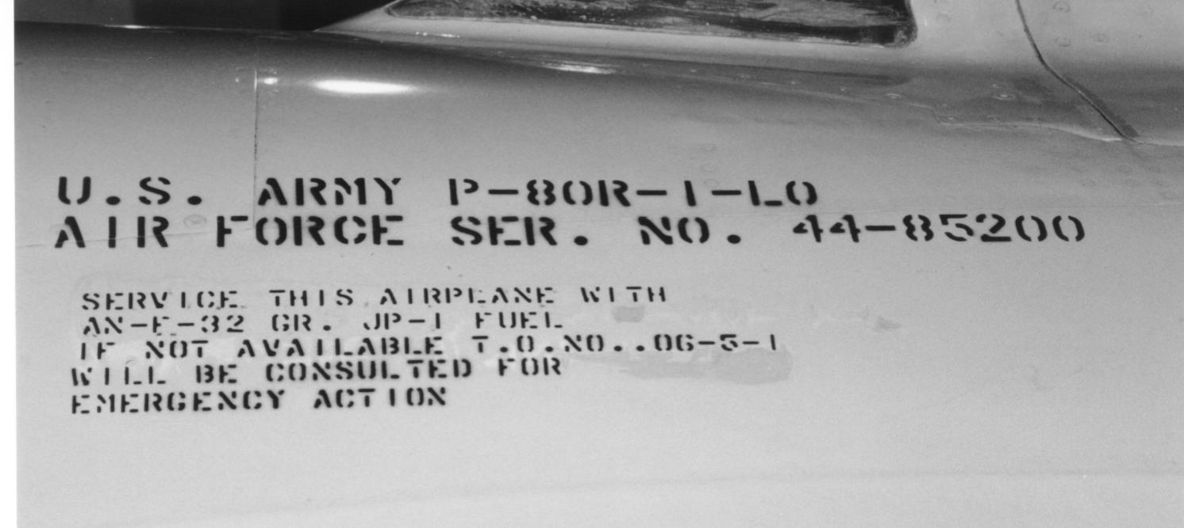
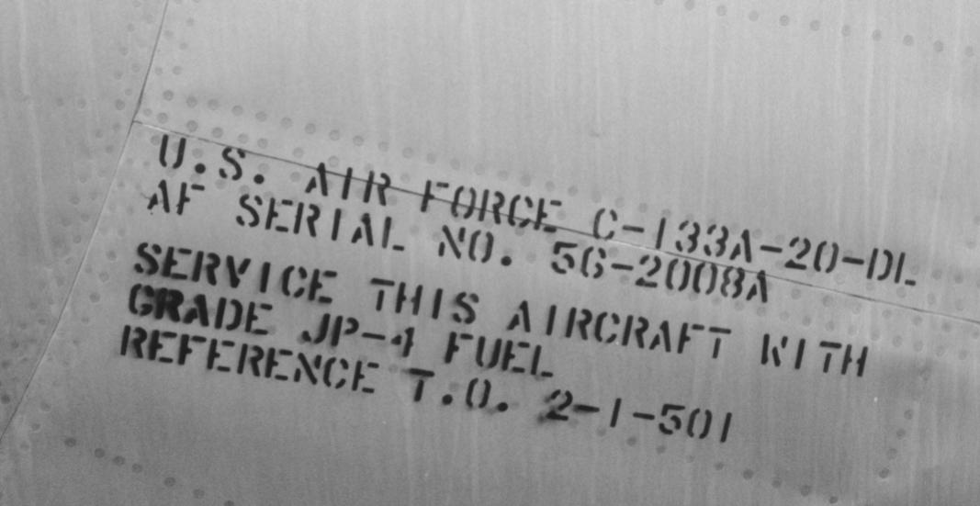
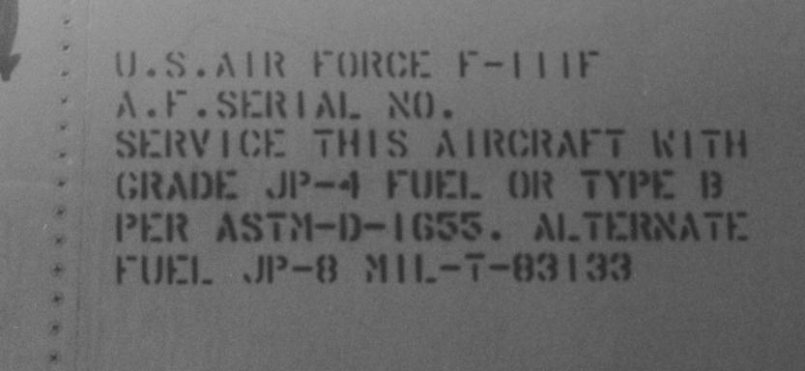
More Fine Print
P-80: JP-1
C-133, B-52, B-58 etc.: JP-4
1980s planes: JP-4 or JP-8

Slide 24
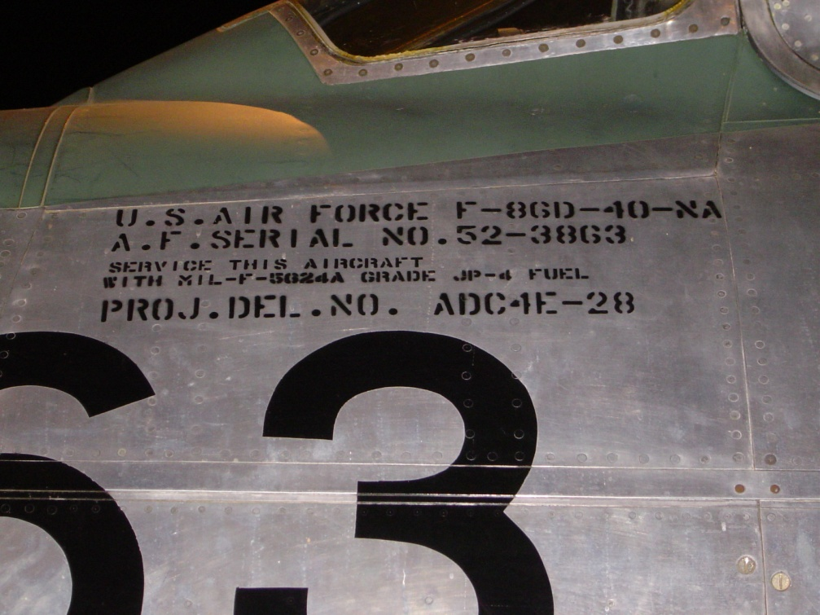
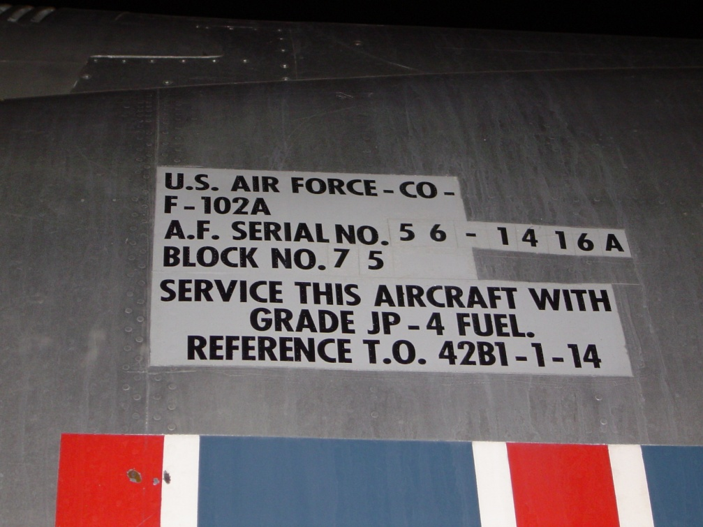
Fine Print (cont.)

Slide 25
Jet Fuel Additives
0.1-0.15 vol%
CH₃
~70 mg/L (typ)
HOCH₂CH₂OCH₂CH₂OCH₃
-(CH₂-C=CH)_{~20}
( -OH, =O, etc.)_{n}
fuel-soluble “tail”
polar “head”
FSII
fuel system icing inhibitor
dispersant
Jet A-1
JP-8
JP-8+100
CI/LI
corrosion inhibitor/
lubricity improver
ASA
anti-static additive
AO
anti-oxidant
C₁₇ - COOH dimer
C/H/O/S polymer
+
polyamine
+
R-SO₃H stabilizer
QPL-25017-17
typ. ~20 g/m3 (mg/L)
C(CH₃) ₃
MDA
metal deactivator
H₃C
OH
CH₃
(CH₂)₄CH₃
C(CH₃) ₃
N
N
(CH₂)CH=CH(CH₂)₄CH₃
OH
HO
Stadis 450
5 mg/L
25 mg/L
BHT
10 mg/L
(CH₂)₈COOH
(CH₂)₈COOH

Slide 26
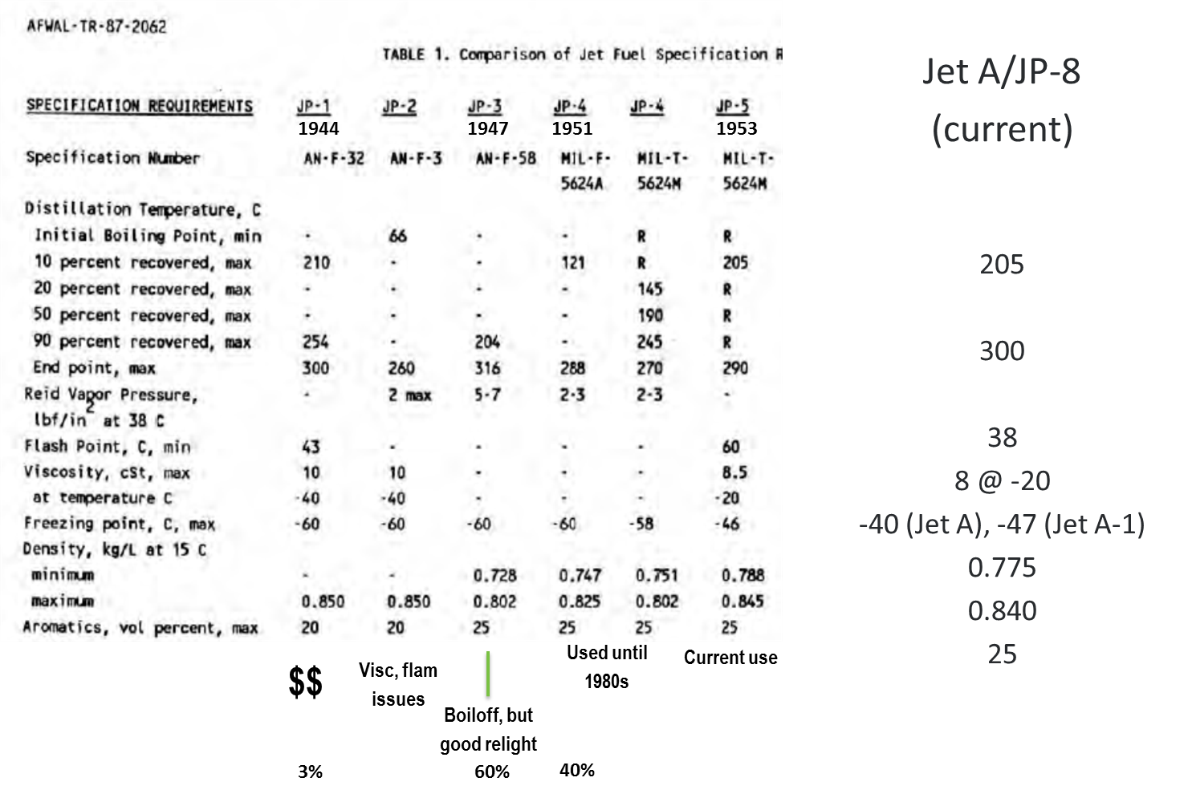
How Did We Get Here?

Slide 31
Single fuel?
135 pages of quality control procedures for multiple grades of fuel

Slide 32
Fuel Specifications
NATO STANDARD AFLP-3747, GUIDE SPECIFICATIONS (MINIMUM QUALITY STANDARDS) FOR AVIATION TURBINE FUELS (F-24, F-27, F-34, F-35, F-37, F-40 AND F-44), Edition C Version1, AUGUST 2017.

Slide 33

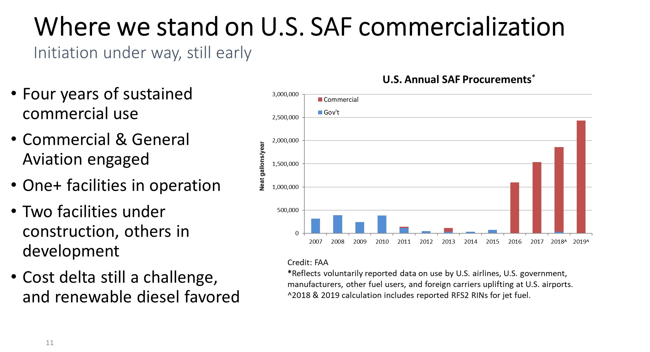
The Future

Slide 35
Specialty Jet Fuels
Higher thermal stability fuels: JP-6 (XB-70), JP-7 (SR-71)
  More highly processed to reduce fuel system deposit formation (more later!)
Lower freeze point fuels for high altitude aircraft: JP-TS (U-2)
Higher density missile fuels: JP-10 (ALCM etc.)
  Not a petroleum distillate
  Range ~ density
JP-10
exo-tetrahydrodi(cyclopentadiene)

Slide 36
Fuel Specification Requirements (1)
Heat of Combustion - Range
Specific Gravity (Density) - Range
Volatility - Altitude Relight, Cold Weather Starting
Viscosity - Altitude Relight, Cold Weather Starting
Hydrogen Content - Combustor Liner Durability, Smoke
Aromatics - Combustor Liner Durability, Smoke
Naphthalenes - Combustor Liner Durability, Smoke
Sulfur - Emissions, Hot Section Life
Smoke Point - Smoke
Thermal Stability - Control Valve Sticking, Nozzle Spray Pattern and Life
Existent Gum - Control Valve Sticking

Slide 37
Fuel Specification Requirements (2)
Acidity - fuel system corrosion, elastomer life
Mercaptan Sulfur - fuel system corrosion elastomer life
Aromatics - elastomer sealing
Vapor Pressure - tank construction
Copper Strip Corrosion - fuel system corrosion
Thermal Stability - fouling/coking fuel lines
Existent Gum - sticking in valves, fuel controls
Particulates - plug small orifices
Filtration Time - plug small orifices (very fine particles)
WSIM - water separation
Flash Point - fire safety
Freeze Point - low temperature pumpability

Slide 38
Fuel Additives
Anti-icing additive (FSII)
  Prevent water from freezing in fuel
Antioxidant
  Improve storage stability and thermal stability
Corrosion inhibitor
  Enhance lubricity, pipeline corrosion prevention
Antistatic
  Reduce static electricity - prevent fires
Metal deactivator
  Chelate trace metals that decrease thermal stability
Thermal stability additive
  Reduce fouling/coking

